Slide 1
Advanced Microelectronics Lab
amr.alaa@guc.edu.eg
C3.305 (Back office)
Sandy.abdelmalak@guc.edu.eg
C3.207

Slide 2
Hints
General hints
Make sure that basys-3 board is selected for the project
Board XC7A35T-ICPG236
Constraint file is case sensitive
For vectors, use [ ] for port mapping (e.g. X[0] )
Run behavioral simulation to verify functionality if needed

Slide 3
VGA Control
Recap
Display Fixed Color
Display Fixed Images with memory IP

Slide 4
VGA Control
Task 1
Moving Images
Image must slide gradually at the edges and re-appear at the opposite edge simultaneously (for vertical and Horizontal motion)
X1 | X0 | Action
0 | 0 | Stop The Image
0 | 1 | Moving Vertically
1 | 0 | Moving Horizontally
1 | 1 | Moving Diagonally

Slide 5
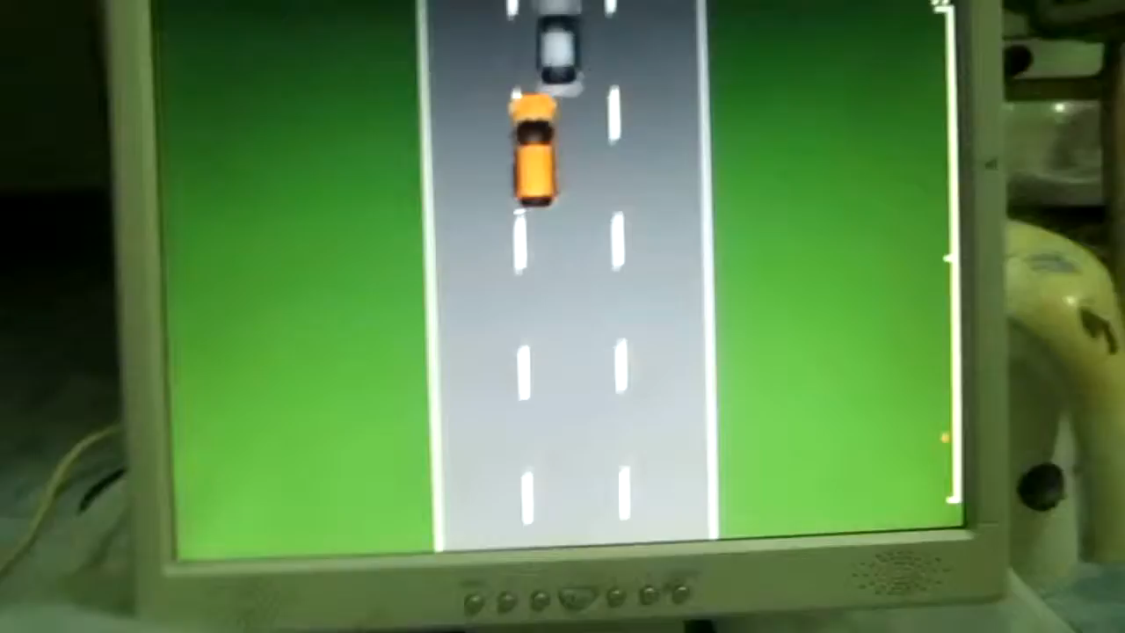
Task 2: Racing Cars Game One Player Vs. automated flow of cars

Slide 6
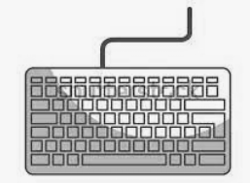

Task 2: Racing Cars Game One Player Vs. automated flow of cars
Keyboard interface with VGA display
FPGA

Slide 7
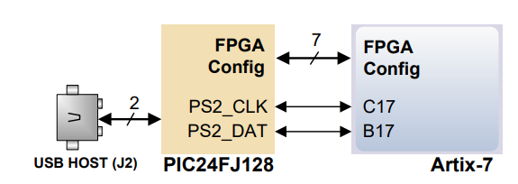
Keyboard Interface
The interface between the FPGA and the keyboard is achieved through USB HID host. Two signals are used for the ps/2 communication interface with the keyboard.

Slide 8
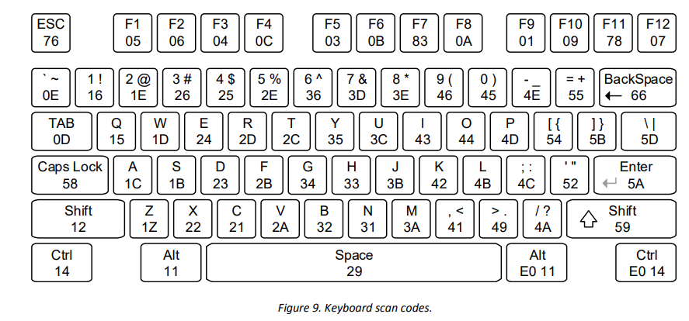
Keyboard Interface
PS/2-style keyboards use scan codes to communicate key press data. Each key is assigned a code that is sent whenever the key is pressed. If the key is held down, the scan code will be sent repeatedly about once every 100ms. When a key is released, an F0 key-up code is sent, followed by the scan code of the released key.

Slide 9
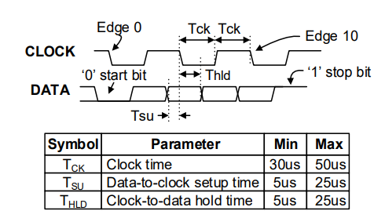
PS/2 Communication Interface
PS/2 is a serial communication using a 2-wire bus. The keyboard use 11-bit words that include a start bit, data byte (LSB first), odd parity, and stop bit. The clock and data signals are only driven when data transfers occur; otherwise they are held in the idle state at logic '1‘.

Slide 10
Debounce Circuit
It is the process of eliminating the possibility of the production of rippled signals after a single key press, resulting in a more consistent movement.
In your VHDL code, the debounce circuit has to wait for a specific amount of time (you must learn how to estimate this time) without any variations in the value to make sure that it is an actual key press and not some flicker or noise.

Slide 11
Required VHDL Modules
Moving image implementation *Required
Keyboard ps/2 module implementation *Required
Scan codes to ASCII conversion (given)
ASCII to pixel representation (given)
Interface between pixel representation and your VGA implementation *Required
Racing game implementation (single player) *Required
Any Codes copied from other resources (online or offline) will result in a grade of ZERO with no negotiations

Slide 12
Thank You

